Slide 1
Proyek DAPUR UNI
Kelompok 4

Slide 2
Nama Anggota:
MUHAMMAD FATUR RAHMAN (10122911)
DIMAS ROBBI KASLANOVA (10122389)
IAN SHEVA SATRIA RAMADHAN (10122611)
IRFAN AFIF LUTBIANTO (10122636)

Slide 3
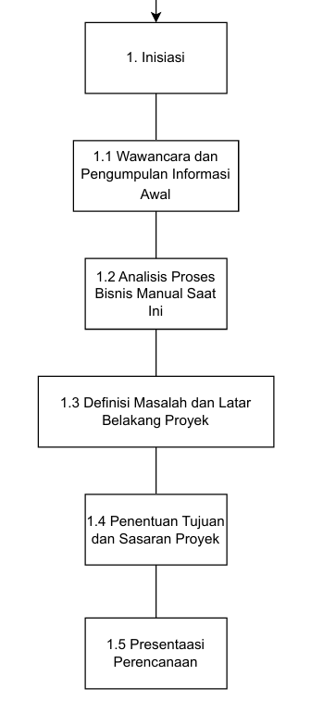
Work Breakdown Structure

Slide 4

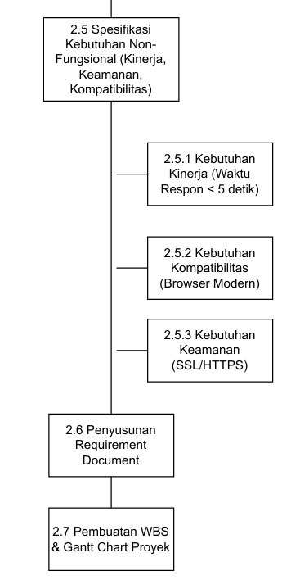
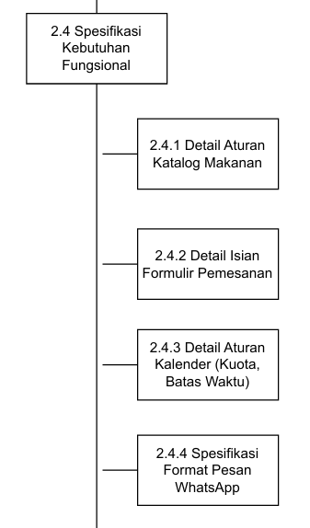

Slide 5
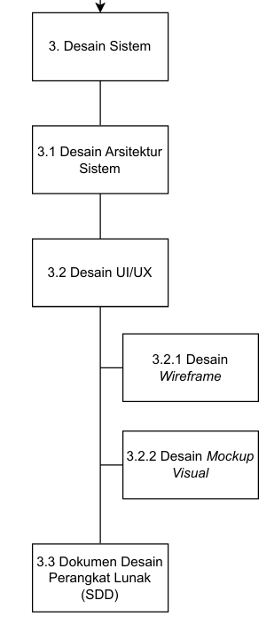

Slide 6



Slide 7

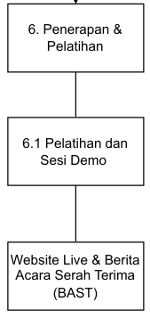

Slide 8




Slide 9




Slide 10




